Slide 1



Sales Analysis Report
View in Power BI
Last data refresh:
3/15/2023 12:34:26 PM UTC
Downloaded at:
3/16/2023 7:36:56 AM UTC

Slide 2
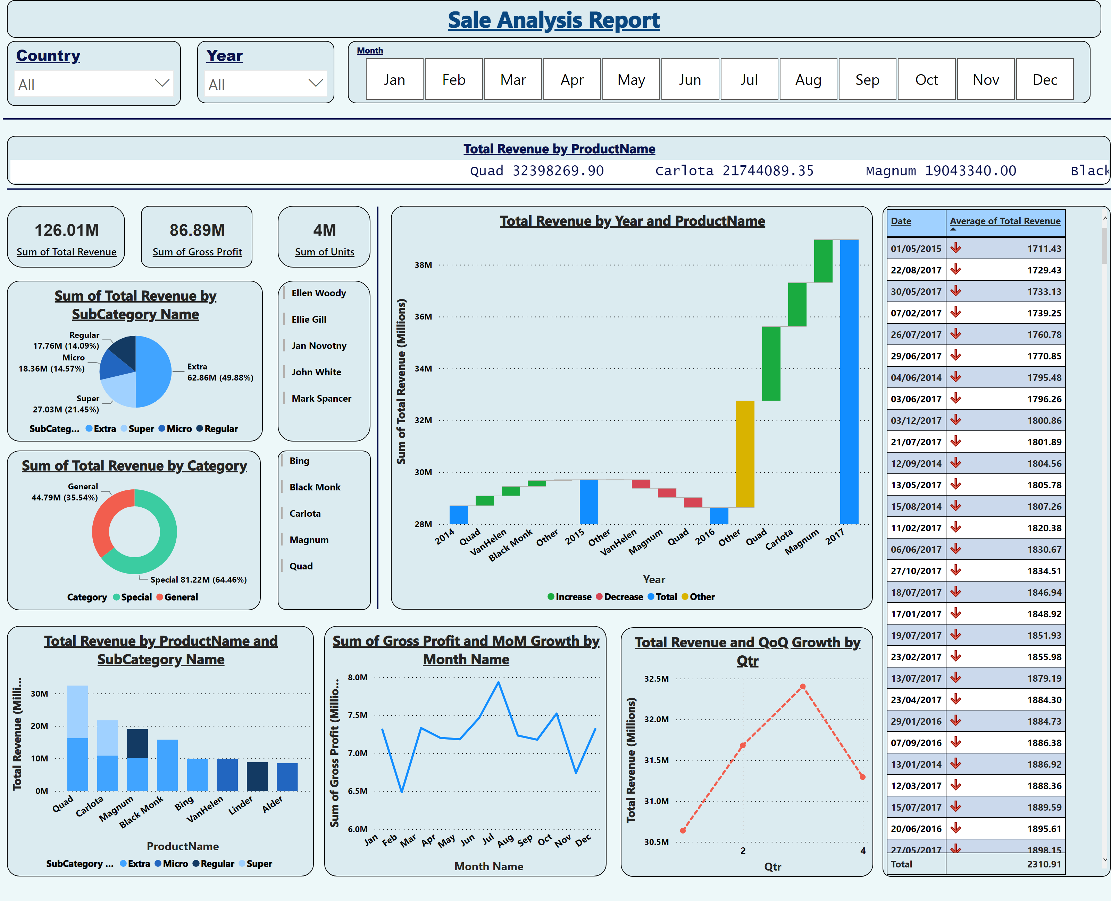
Sale Report
Notes:
textbox
No alt text provided
slicer
No alt text provided
slicer
No alt text provided
slicer
No alt text provided
shape
No alt text provided
shape
No alt text provided
card
No alt text provided
card
No alt text provided
card
No alt text provided
pieChart
No alt text provided
donutChart
No alt text provided
Top 5 Sale Men by Gross Profit
No alt text provided
ScrollingTextVisual1448795304508
No alt text provided
Total Revenue by Year and ProductName
No alt text provided
columnChart
No alt text provided
Top 5 Product by Gross Profit
No alt text provided
shape
No alt text provided
lineChart
No alt text provided
lineChart
No alt text provided
tableEx
No alt text provided

Slide 3
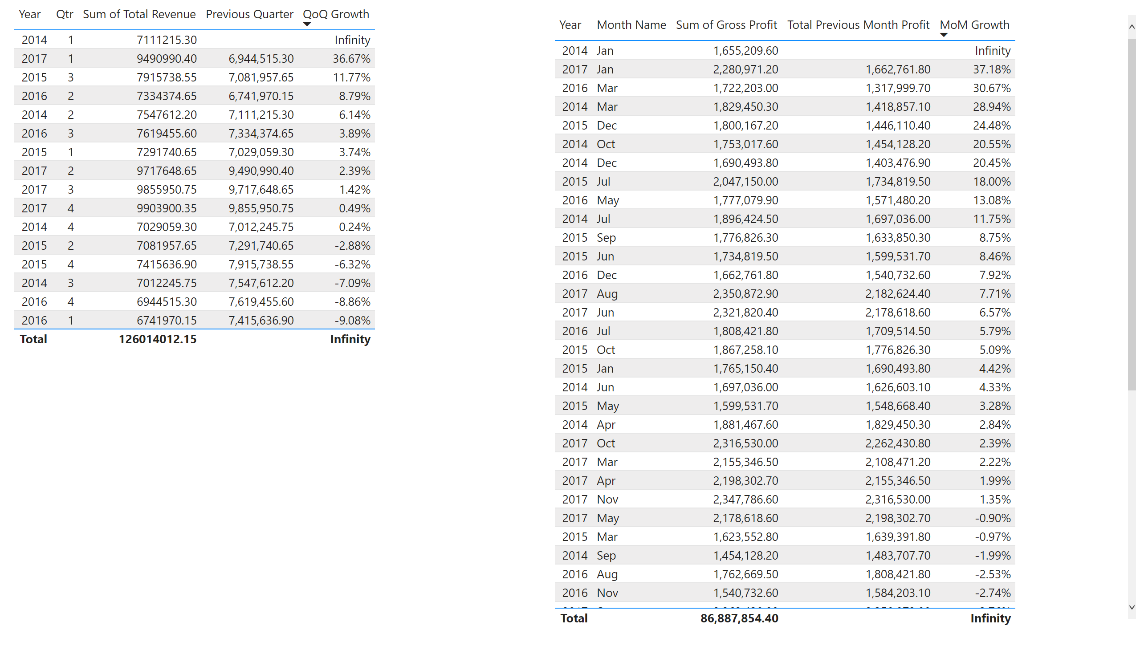
Quarter Report
Notes:
tableEx
No alt text provided
tableEx
No alt text provided

Slide 4
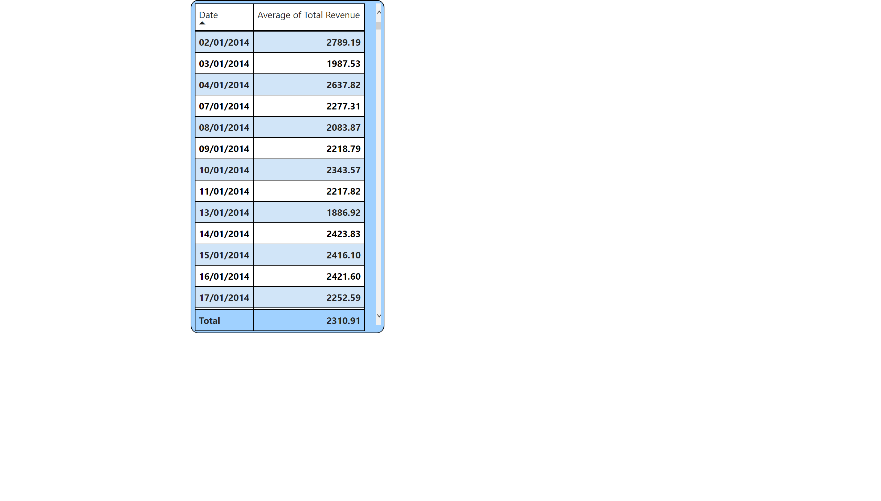
Avg total revenue
Notes:
tableEx
No alt text provided

